Slide 1
Heat related illness:prevention and managment
Christopher Lewis MSN APRN-FNP
Sports Medicine: Brunner Sanden Deitrick Wellness Center

Slide 2
Heat related illness
Hyperthermia occurs when the body’s heat-regulating mechanisms don't work effectively. Older age, certain illnesses, and medications increase the risk of developing hyperthermia.
The body maintains temperature homeostasis via four main mechanisms: (1) conduction (ex contact with hot or cold surface), (2) convection (ex a cool breeze or contact with water), (3) radiation (ex proximity to hot equipment), and (4) evaporation (ex sweating). When the body is unable to adequately regulate homeostasis using these methods, heat illness occurs.

Slide 3
Heat related illness
Incidence of heat related illness-
According to the CDC every year on average in the US there are:
    702 heat related deaths
    67,512 ER visits
    9,235 hospitalizations
According to the US Bureau of Labor in 2019 there were 43 work related deaths due to heat. This was lower than the high of 61 deaths in 2011 but higher than the number in all but one year from 2012 to 2018.

Slide 4
Heat related illness
Signs of heat illness-
  HEAT EDEMA- Swelling of feet and ankles due to vasodilatation (widening of the blood vessels) and venous stasis (decreased return of venous blood). Treatment is removal to cool environment and elevation of the limbs
  HEAT SYNCOPE- Simple transient loss of consciousness or collapse may occur suddenly after exertion in the heat. The patient’s skin is cool and moist, the pulse is weak, and transient hypotension (low blood pressure) occurs. Treatment is rest in a recumbent (lying down) position, cooling, and oral rehydration.
  HEAT CRAMPS- Spasms of the voluntary muscles of the abdomen and extremities. This is caused by electrolyte depletion (Sodium and Potassium). Treatment consists of fluid and salt replacement. (eg. Sports drinks, Salt tablets). Place the patient in a cool place, and massage/stretch muscles gently. The patient should avoid intense physical exertion for 1–3 days, depending on the severity.

Slide 5
Heat related illness
HEAT EXHAUSTION- A systemic reaction to prolonged heat exposure (hours to days) and is due to sodium depletion, dehydration, accumulation of metabolites, or a combination of these factors. It is a premonitory syndrome that rapidly evolves to heat stroke. Central nervous system symptoms are not present, and the core body temperature is usually less than 40°C (104°F) and can be normal.
    Two types of heat exhaustion- Most cases a combination of both
    Hypernatremic (primary water loss) Heat exhaustion from primary water loss occurs when an individual in a hot environment lacks appropriate hydration.
    Hyponatremic (primary sodium loss). Heat exhaustion from primary salt loss occurs when an individual in a hot environment sweats excessive amounts and replaces fluid losses with water.

Slide 6
Heat related illness
HEAT EXHAUSTION (cont)- Signs and symptoms of heat exhaustion are nonspecific and include headache, nausea, vomiting, malaise, muscle cramps, and dizziness. Dehydration is manifested by tachycardia, hypotension, and diaphoresis.
  Initial treatment includes placing the patient in a cool place and giving adequate oral hydration. If the patient is unable to drink fluids they should be taken to the hospital.

Slide 7
Heat related illness
HEAT STROKE- Characterized by dysfunction of the heat regulating mechanism, with altered mental status (ranging from confusion to coma) and elevated core body temperature in excess of 40°C (104°F).
  Sweating is variable. The extremely high body temperature can rapidly cause widespread damage to body tissues, with significant rhabdomyolysis (rapid breakdown of muscle tissue) and multiorgan dysfunction.
  Illness and death result from destruction of cerebral, cardiovascular, hepatic, and renal tissue. Heat stroke has the highest mortality of all heat-related illnesses, however, prompt cooling yields favorable survival rates (90–100%).

Slide 8
Heat related illness
Heat Stroke (cont)- Initial symptoms include headache, dizziness, nausea, diarrhea, and visual disturbances. Most patients have profound central nervous system dysfunction including seizures, delirium, ataxia, and coma. The skin is hot, flushed, and usually dry (although sweating may be present). Treatment should include placing the patient in a shady, cool place and remove his or her clothing. Sprinkle the patient’s entire body with water, and cool by fanning, which will promote evaporative cooling and immersion in cool (not cold) water if possible. Emergency Services should be contacted ASAP.

Slide 9
Heat related illness
Management of Heat Stress- Implementation of controls to mitigate heat stress
Environmental Controls-
  Increase air velocity, use reflective or heat-absorbing shielding or barriers, reduce steam leaks, wet floors, or humidity.
Work Practice Controls-
  Limit time in the heat and/or increase recovery time spent in a cool area.
  Reduce the metabolic (physically difficult) demands of the job (ex. by use of tools or increased workers per task).
  Train supervisors and workers about heat stress.
  Use a buddy system where workers observe each other for signs of heat-related illnesses.
  Use a heat alert program whenever the weather service forecasts a heat wave
  Institute a heat acclimatization plan and encourage increased physical fitness.

Slide 10
Heat related illness
Training- for all workers and supervisors about the following:
  Recognition of the signs and symptoms of heat-related illnesses and administra­tion of first aid.
  Causes of heat-related illnesses and steps to reduce the risk. These include drinking enough water and monitoring the color and amount of urine output.
  Proper care and use of heat-protective clothing and equipment and the added heat load caused by exertion, clothing, and per­sonal protective equipment.
  Effects of other factors (drugs, alcohol, obesity, etc.) on tolerance to occupational heat stress.
  The importance of acclimatization.
  The importance of immediately reporting any symptoms or signs of heat-related illness in themselves or in coworkers to the supervisor.
  Procedures for responding to symptoms of possible heat-related illness and for contacting emergency medical ser­vices.

Slide 11
Heat related illness
Supervisors should also be trained on the following:
  Implementing appropriate acclimatization.
  What procedures to follow when a worker has symptoms of heat-related illness, including emergency response procedures.
  Monitoring weather reports.
  Responding to hot weather advisories.
  Monitoring and encouraging adequate fluid intake and rest breaks.

Slide 12
Heat related illness
Reducing heat burden- Wearing PPE and certain clothing ensembles can often increase your risk for heat-related illnesses. PPE (e.g., waterproof aprons, surgical gowns, surgical caps, respirators, face shields, boots, and gloves)
  Reduces the body’s normal way of getting rid of heat by sweating and other means.
  Holds excess heat and moisture inside, making the worker’s body even hotter.
  Increases the physical effort to perform duties while carrying the extra weight of the PPE and can lead to the worker getting hotter faster (e.g., working muscle increases body heat production).

Slide 13
Heat related illness
Acclimatization- Acclimatization is the result of beneficial physiological adaptations (e.g., increased sweating efficiency, etc.) that occur after gradual increased exposure to a hot environment. Employers should ensure that workers are acclimatized before they work in a hot environment.
  Gradually increase workers’ time in hot conditions over 7 to 14 days.
  Closely supervise new employees for the first 14 days or until they are fully acclimatized.
  Workers who are not physically fit need more time to fully acclimatize.
  Acclimatization can be maintained for a few days of non-heat exposure.
  Taking breaks in air conditioning will not affect acclimatization.

Slide 14
Heat related illness
Hydration- Workers should drink an appropriate amount to stay hydrated-
  For moderate activities in the heat that last less than 2 hours, drink 1 cup (8 oz.) of water every 15–20 minutes.
  If sweating lasts for several hours, drink sports drinks containing balanced electrolytes.
  Avoid alcohol and drinks with high caffeine or sugar.
  Generally, fluid intake should not exceed 6 cups per hour.
  Properly hydrated worker should have urine that is a light yellow color

Slide 15
Heat related illness
Rest Breaks- Employers should ensure and encourage workers to take appropriate rest breaks t o cool down and hydrate.
  Permit rest and water breaks when a worker feels heat discomfort.
  Modify work/rest periods to give the body a chance to get rid of excess heat.
  Assign new and unacclimatized workers lighter work and longer, more frequent rest periods.
  Shorten work periods and increase rest periods:
    As temperature, humidity, and sunshine increase.
    When there is no air movement.
    If protective clothing or equipment is worn.
    For heavier work.

Slide 16
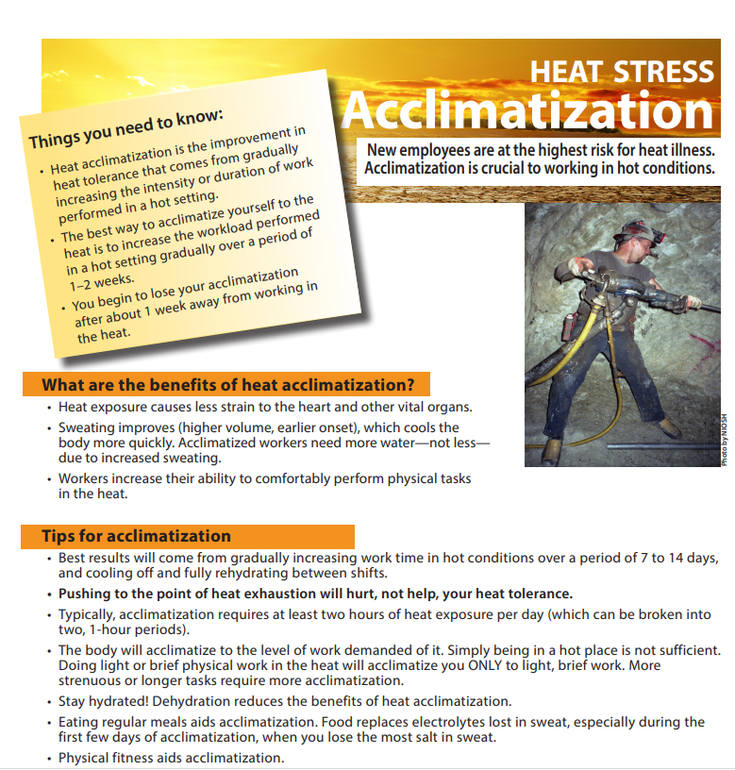

Slide 17


Slide 18
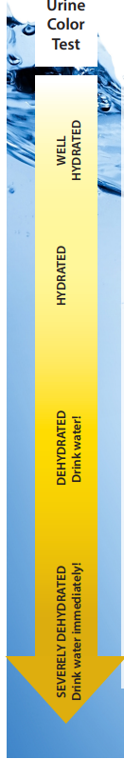

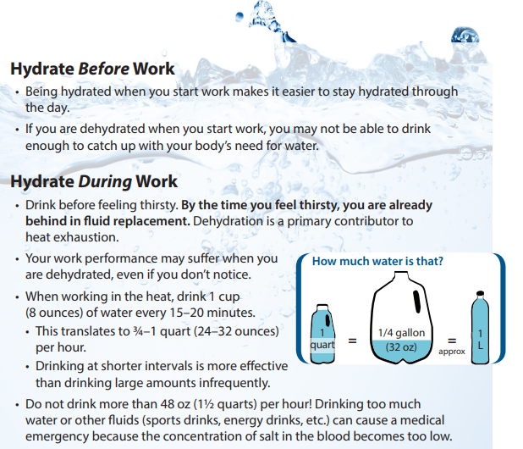
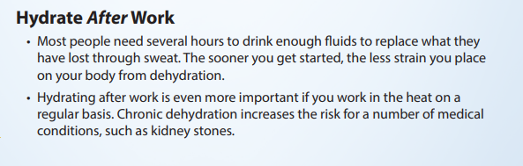

Slide 19
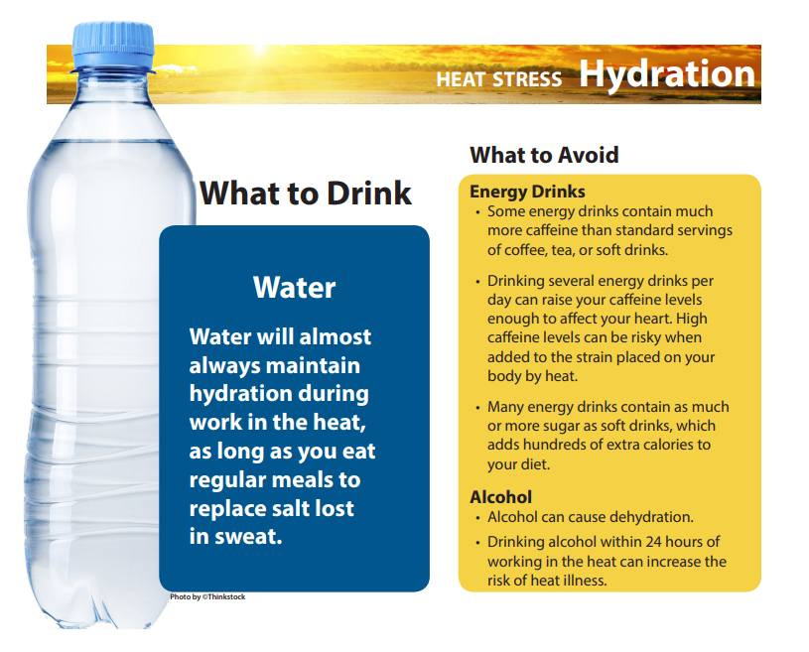

Slide 20
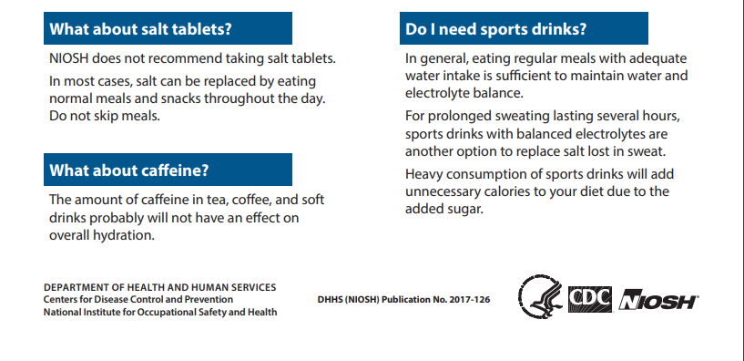

Slide 21
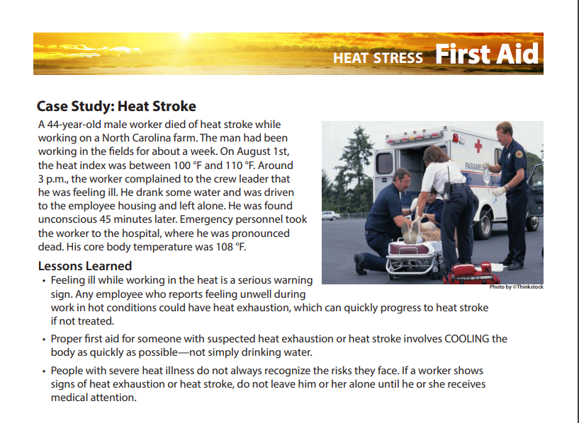


Slide 22
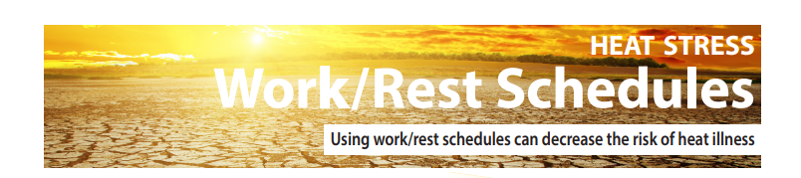
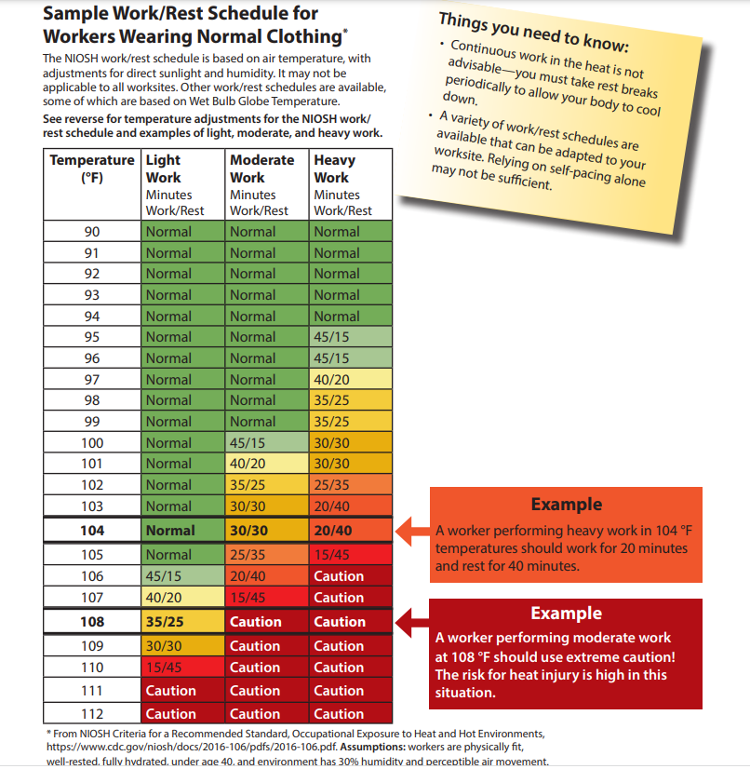

Slide 23
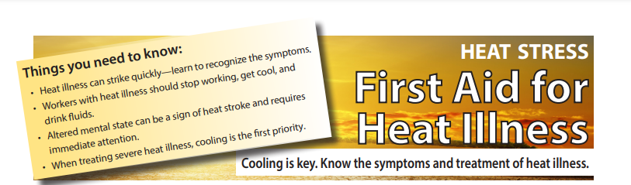
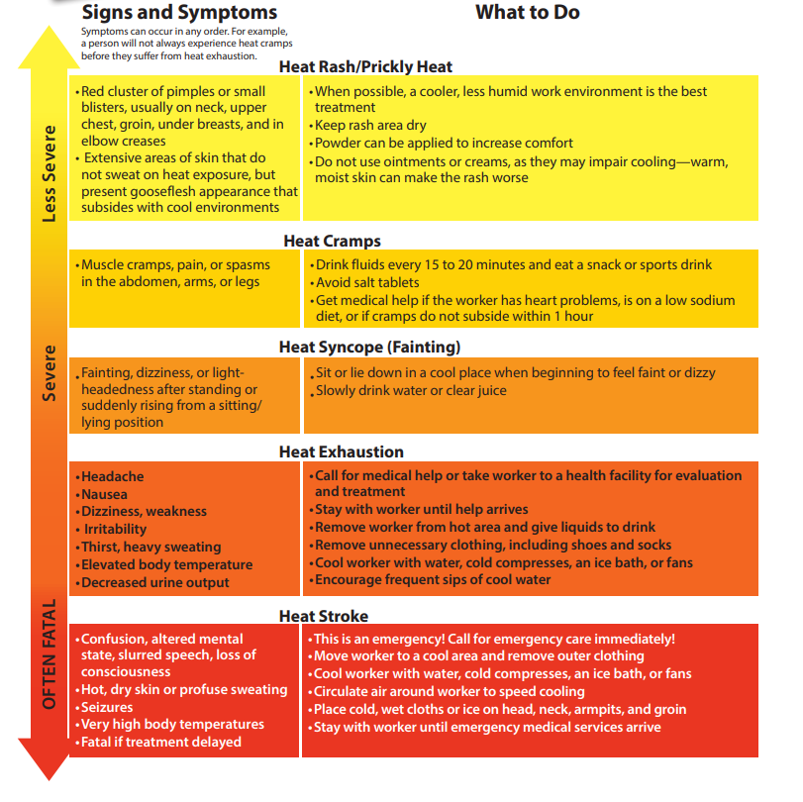

Slide 24
Reference
Bowers R.C., & Vivolo J.C. (2017). Disorders due to physical & environmental agents. Stone C, & Humphries R.L.(Eds.), CURRENT Diagnosis & Treatment: Emergency Medicine, 8e. McGraw Hill. https://accessemergencymedicine.mhmedical.com/content.aspx?bookid=2172&sectionid=165069554
Centers for Disease Control (2023). Heat & Health Tracker. https://ephtracking.cdc.gov/Applications/heatTracker/
The National Institute for Occupational Safety and Health (NIOSH)(2018, June 6). Acclimatization. https://www.cdc.gov/niosh/topics/heatstress/acclima.html
The National Institute for Occupational Safety and Health (NIOSH). )(2018, June 6). Limiting Heat Burden While Wearing Personal Protective Equipment (PPE). https://www.cdc.gov/niosh/topics/heatstress/heat_burden.html
Bureau of Labor Statistics, U.S. Department of Labor, The Economics Daily, 43 work-related deaths due to environmental heat exposure in 2019 at https://www.bls.gov/opub/ted/2021/43-work-related-deaths-due-to-environmental-heat-exposure-in-2019.htm (visited May 30, 2023).

